Slide 1
TNSDC-Generative AI
Handwritten Recognition System using CNN
Presented by : Madhan kumar.K,
au211521104082,
Pre-Final Year Student,
Computer Science and Engineering,
Panimalar Institute of Technology.

Slide 2

OUTLINE
Problem Statement
Proposed Solution
System Approach
Algorithm
Result
Conclusion
References

Slide 3
PROBLEM STATEMENT
The aim is to develop a robust handwritten digit recognition system capable of accurately identifying digits (0-9) from handwritten images. For this, Convolutional Neural Network (CNN) is utilized and also the system should be able to handle various styles of handwriting and noise levels, providing reliable recognition performance across different datasets. The goal is to achieve high accuracy while maintaining efficiency in processing time.

Slide 4
PROPOSED SOLUTION
Utilizing Convolutional Neural Network (CNN) architecture implemented in PyTorch, a web-based handwritten digit recognition system will be developed. The system will consist of multiple layers of convolutional and pooling operations to extract relevant features from handwritten digit images.
Training data will be fed into the CNN model to learn and optimize the parameters through backpropagation. Techniques such as data augmentation and regularization will be employed to improve generalization and prevent overfitting.
Upon training completion, the model will be integrated into a Flask web application, allowing users to upload images of handwritten digits through a user-friendly interface. The uploaded images will be preprocessed and fed into the trained CNN model for inference.
The predicted digit labels will be returned to the user interface, providing real-time feedback on the recognized digits. Additionally, the system will be optimized for efficiency to ensure low latency in processing, enabling seamless integration into various applications requiring handwritten digit recognition on the web.

Slide 5
SYSTEM APPROACH
Hardware:
CPU: The system requires a CPU with sufficient processing power to handle the computational demands of Convolutional Neural Network (CNN) training and inference. A multi-core processor, preferably with a clock speed of at least 2 GHz or higher, is recommended.
Memory: A minimum of 8 GB RAM is recommended for smooth operation, especially during model training, where large datasets are processed. More RAM may be required for handling larger datasets or concurrent user requests.
Internet Speed: A stable internet connection is necessary for downloading and updating Python packages, model weights, and serving the web application. A broadband connection with a minimum download speed of 5 Mbps and upload speed of 1 Mbps is sufficient for most purposes.

Slide 6
SYSTEM APPROACH – CONT.
Software:
Python: The system is built using Python programming language
PyTorch: PyTorch, a machine learning library, is utilized for implementing the Convolutional Neural Network (CNN) architecture. PyTorch provides efficient tensor computation with GPU acceleration, facilitating faster model training and inference.
NumPy: NumPy is a fundamental package for scientific computing in Python, essential for handling multidimensional arrays and mathematical operations. It is used extensively for data preprocessing, manipulation, and numerical computations within the CNN model.
TorchVision: TorchVision, a PyTorch library, provides datasets, transforms, and utilities for computer vision tasks. It is used for loading and preprocessing handwritten digit image datasets, facilitating seamless integration with the CNN model for training and evaluation.

Slide 7

ALGORITHM
Phase 1: Data Preparation and Preprocessing
Load the handwritten digit image dataset, such as MNIST or USPS, using TorchVision, a PyTorch library.
Preprocess the dataset by normalizing pixel values to a range between 0 and 1 to facilitate convergence during training.
Split the dataset into training, validation, and testing sets using PyTorch utilities, ensuring a balanced distribution of digits across sets.
Phase 2: Model Training
Define a Convolutional Neural Network (CNN) architecture using PyTorch, comprising convolutional layers, pooling layers, and fully connected layers.
Initialize the CNN model parameters and specify the loss function (e.g., cross-entropy loss) and optimizer (e.g., stochastic gradient descent) using PyTorch.
Train the CNN model using the training dataset, iterating over mini-batches of data, and updating model parameters through backpropagation.
Validate the trained model using the validation dataset to monitor performance and prevent overfitting by adjusting hyperparameters (e.g., learning rate, dropout probability) if necessary.
Optionally, perform data augmentation techniques using TorchVision, such as random rotations or translations, to enhance model generalization.

Slide 8
ALGORITHM - CONT.
Phase 3: Final Model Creation
Create a final trained model instance under the name "server" using PyTorch, incorporating the best-performing model parameters obtained during training.
Save the "server" model weights to disk for later deployment as a web application.
Phase 4: Web Application Deployment
Implement a web application using Flask, a lightweight Python web framework, to serve as the interface for testing the handwritten digit recognition model.
Load the "server" model weights and architecture into memory using PyTorch within the Flask application.
Design the web interface to allow users to input handwritten digit images or draw digits using a canvas element.
Preprocess the user input, converting it into a format suitable for inference with the CNN model.
Pass the preprocessed image data through the "server" model for inference, predicting the digit label along with associated probabilities.
Display the predicted digit label and corresponding confidence score to the user interface, enabling real-time feedback on the recognized digit.

Slide 9
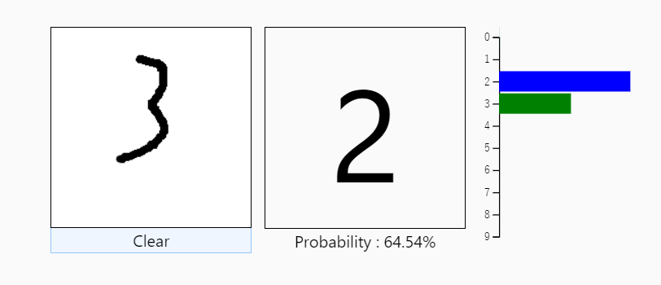
RESULT
Figure 1
9

Slide 10
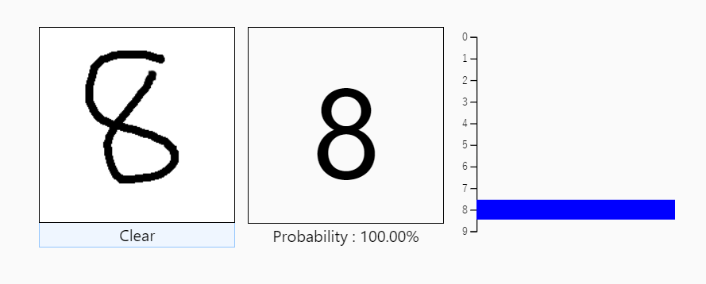
RESULT
Figure 2
10

Slide 11
Conclusion
The implemented handwritten digit recognition system, employing Convolutional Neural Network (CNN) architecture with PyTorch and Flask for web deployment, stands operational on localhost. Presently, users can test the model's performance in real-time. For future development, optimizing the system's performance with advanced CNN architectures and exploring techniques like transfer learning could enhance accuracy and generalization. Additionally, refining the user interface and deploying on cloud servers could extend accessibility and scalability. Future expansions could include multi-digit recognition capabilities and handling full handwritten text, opening new application domains in finance, education, and digital document processing.
11

Slide 12
REFERENCES
Tensorflow: https://www.tensorflow.org/
Numpy: https://numpy.org/
PyTorch: https://pytorch.org/
Flask: https://flask.palletsprojects.com/en/3.0.x/
Inspiration: https://projectworlds.in/artificial-intelligence-project-handwritten-digits-recognition/
12

